Slide 1

AWS Training

Slide 2
Startup Lab task
Create an AWS Account
Logging into AWS Console
Create a AWS User using IAM
Working with S3 in AWS Console
Configure eclipse with AWS
Working with S3
Import S3 code with eclipse

Slide 3
Amazon Elastic Cloud (EC2)
Amazon Web Service that allows users to rent computers and install their own applications on them
For our Training of project AWS, so we as students can gain experience in cloud computing

Slide 4
AWS S3(Simple Storage Service)
Amazon S3 has a simple web services interface that you can use to store and retrieve any amount of data, at any time, from anywhere on the web.

Slide 5

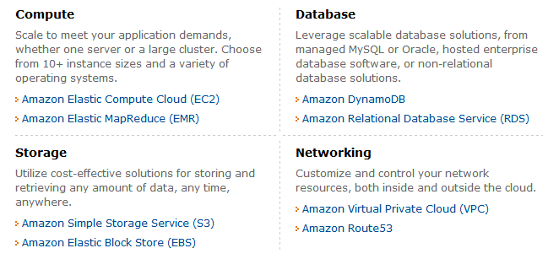
Amazon Web Services (AWS)

Slide 6
Amazon EC2 Functionality
Select a pre-configured, templated image to get up and running immediately. Or create an Amazon Machine Image (AMI) containing your applications, libraries, data, and associated configuration settings.
Configure security and network access on your Amazon EC2 instance.
Choose which instance type(s) and operating system you want, then start, terminate, and monitor as many instances of your AMI as needed, using the web service APIs or the variety of management tools provided.
Determine whether you want to run in multiple locations, utilize static IP endpoints, or attach persistent block storage to your instances.
Pay only for the resources that you actually consume, like instance-hours or data transfer.

Slide 7
EC2 Features
Multiple Locations: Regions/Availability Zones
8 regions: US East (Northern Virginia), US West (Oregon), US West (Northern California), EU (Ireland), Asia Pacific (Singapore), Asia Pacific (Tokyo), South America (Sao Paulo),
Inexpensive, low latency network connectivity to other Availability Zones in the same Region, 99.95% SLA.
Amazon Virtual Private Cloud –secure and seamless bridge between a company’s existing IT infrastructure and the AWS cloud.
Amazon CloudWatch
Auto Scaling
Elastic Load Balancing
VM Import

Slide 8
Instance Types
1EC2CU: equivalent of 1.0-1.2GHz 2007 Opteron or 2007 Xeon processor
Standard Instances:
Small: 1.7GBmem, 1EC2Compute Unit (EC2CU), 160GB local instance storage(lis), 32/64bits.
Medium: 3.75 GBmem, 2EC2CU, 410GBlis, 32/64bits.
Large: 7.5GBmem, 4EC2CU, 850GBlis, 64bits
Extra Large: 15GBmem, 8EC2CU, 1690GBlis, 64bits.
Micro Instances: 613MBmem, 2ECUs, EBS
High-Memory Instances: 17.1, 34.2, 68.4GBs.
High-CPU Instances (5EC2CU or 20EC2CU)
Cluster GPU Instances (22GBmem, 33.5EC2CU, 2xNVIDIA Tesla “Fermi” M2050 GPUs, 1690GBlis, 10GEthernet.

Slide 9
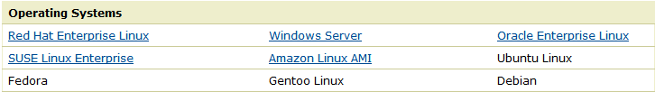
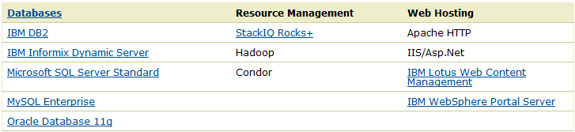
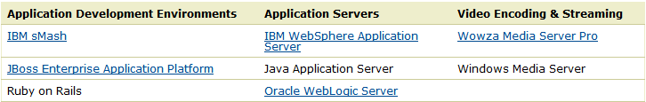
OS and Software
Amazon Machine Images (AMIs) are preconfigured with an ever-growing list of operating systems (win2008OS including in price!!).

Slide 10
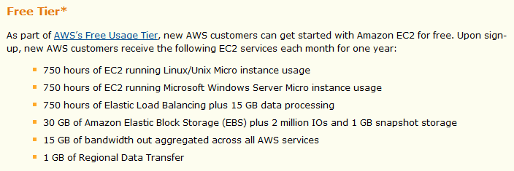
Enticing New Customers

Slide 11
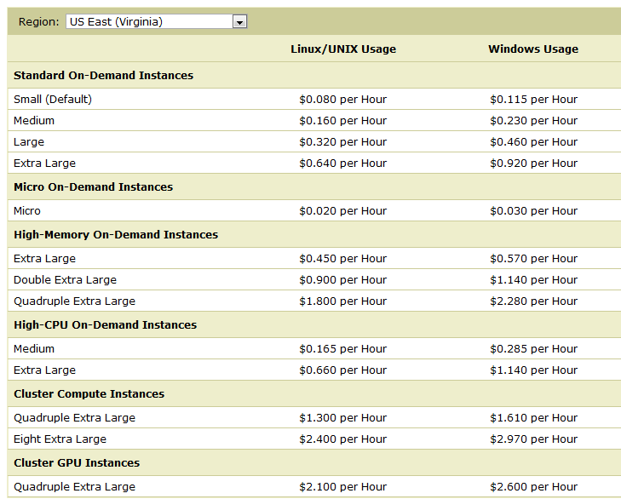
Pricing: On-Demand Instance

Slide 12
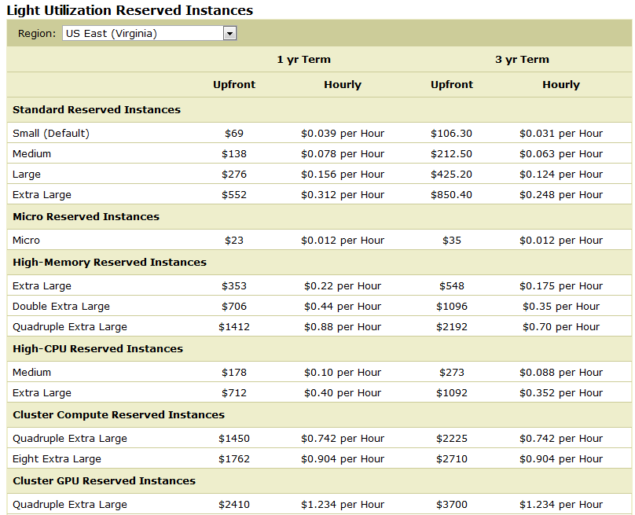
Pricing: Reserved Instances

Slide 13
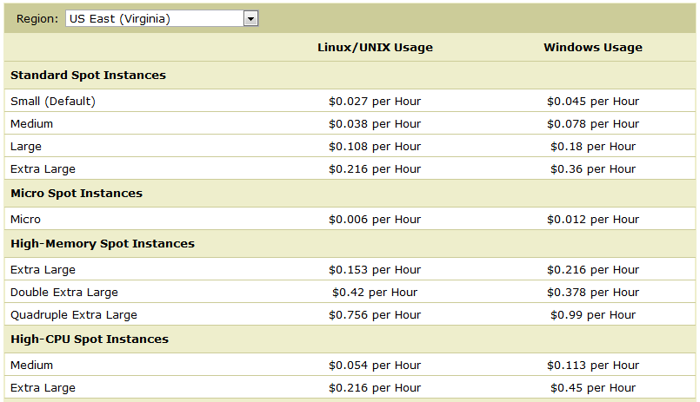
Spot Instances: (Lowest)

Slide 14
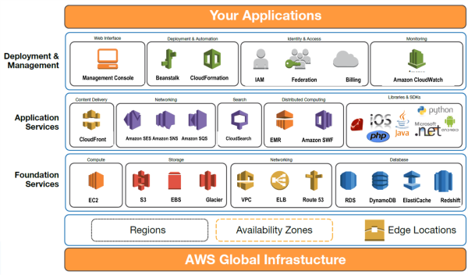
AWS Global Infrastructure

Slide 15
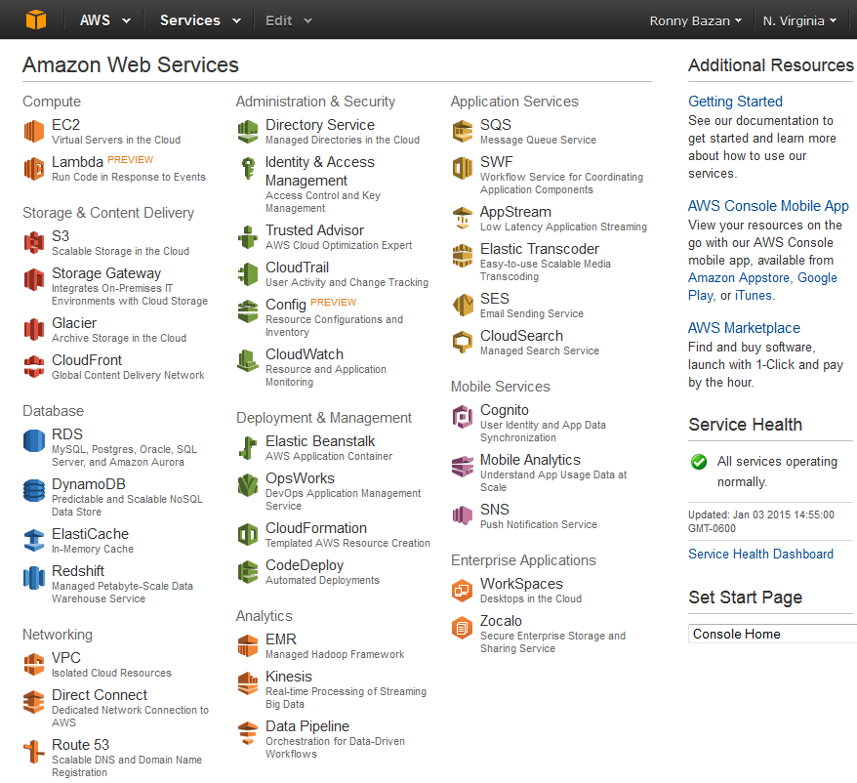
AWS Free-Tier

Slide 16
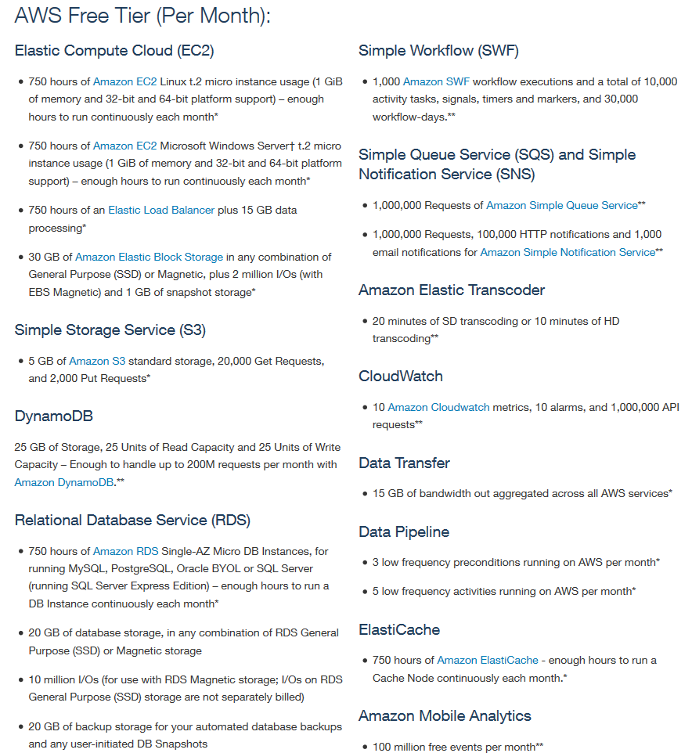
Free Usage Restrictions

Slide 17
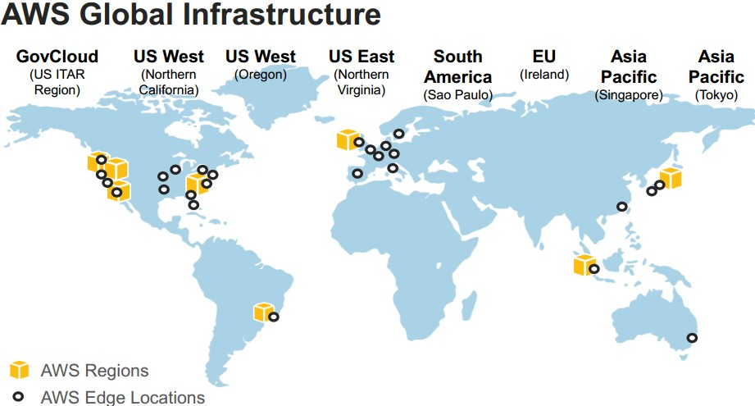
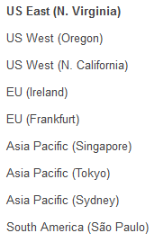
AWS Regions 11 regions, 28 availability zones (1 to 6 data centers)… ~1.4 million servers worldwide!!
More Introduction Information about AWS at – (especially see different networking setups allowed by AWS including ‘Direct Connect’)
http://www.slideshare.net/AmazonWebServices/03-introduction-to-aws

Slide 18
Cost Saving Considerations in AWS
On-Demand Instances
Pay for compute capacity by the hour with no long-term commitments
Reserved Instances
Make a low, one-time payment for each instance you want to reserve and in turn receive a significant discount on the hourly charge for that instance
Spot Instances
Bid on unused EC2 capacity and run those instances for as long as their bid exceeds the current Spot Price

Slide 19
Elastic
Elastic – Amazon EC2 enables you to increase or decrease capacity within minutes, not hours or days.
You can commission one, hundreds or even thousands of server instances simultaneously.
controlled with web service APIs, application can automatically scale itself up and down depending on its needs.
Elastic IP Addresses vs. Static IP Addresses
Interesting charging scheme; you are charged when not using it
programmatically remapping your public IP addresses to any instance in your account

Slide 20
Lab Steps
Amazon Web Services
AWS Architecture
Add AWS Education Credit (free tier)
AWS Account Creation
SSH to instance
Launch instance
Lab – AWS Account Setup, Services Overview, Resource Discovery, and Instance Setup
Purpose of the Lab
Understand definitions of various Amazon Web Services (AWS) and their use in cloud computing based web applications that are accessible over the Internet through an AWS account
Use the AWS account for the discovery, reservation and access of virtual compute/storage infrastructure instances

Slide 21
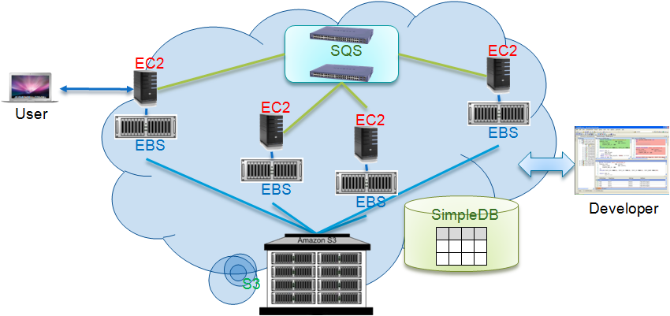
AWS Platform Example Deployment

Slide 22
AWS Execution Environment(AMI-Amazon Machine Image)
Private AMI: Images created by you, which are private by default; you can grant access to other users to launch your private images
Public AMI: Images created by users and released to the community, so anyone can launch instances based on them and use them any way they like
Paid AMI: You can create images providing specific functions that can be launched by anyone willing to pay you per each hour of usage on top of AWS charges

Slide 23
AWS Access Credentials
Credential type you use depends on the type of AWS API
Access Keys
To make secure REST or Query protocol requests to any AWS service API
Parts and Usage
Access Key ID—Your Access Key ID identifies you as the party responsible for service requests; you include it in each request, so it's not a secret
Secret Access Key—Each Access Key ID has a Secret Access Key associated with it; This key is used to calculate the digital signature that you include in the request; Your Secret Access Key is a secret, and only you and AWS should have it
Key Pairs
To launch and then securely access your Amazon EC2 instances
You can make as many as you like by giving friendly names (can’t replace any particular key pair)
Private key that you keep with you; Public key that AWS keeps to allow access

Slide 24
Startup Lab task
Create an AWS Account
Logging into AWS Console
Create a AWS User using IAM
Working with S3 in AWS Console
Configure eclipse with AWS
Working with S3
Import S3 code with eclipse

Slide 25
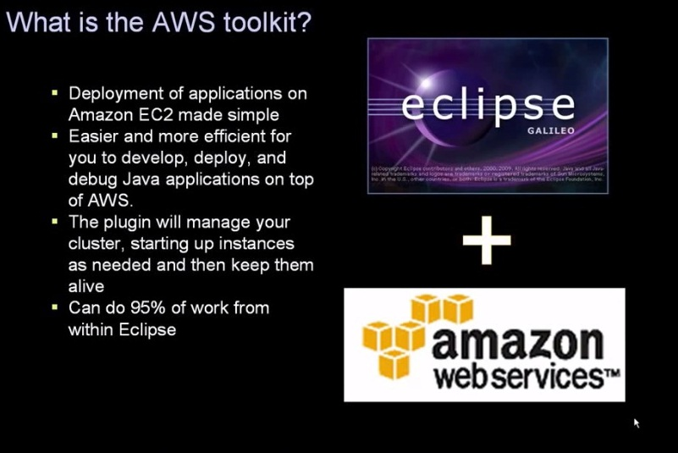
AWS with Eclipse

Slide 26
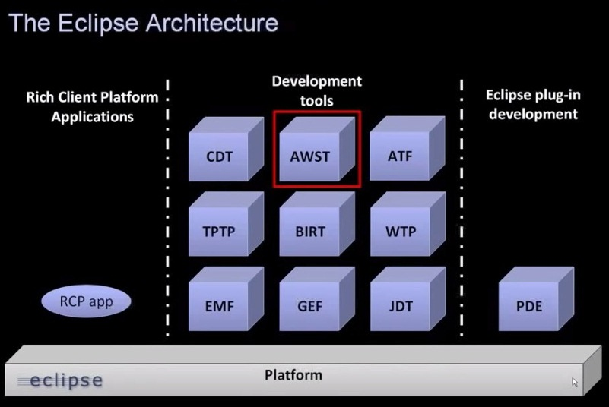
Aws with Eclipse

Slide 27
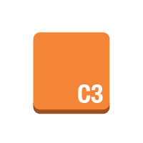














Compute & Networking
Amazon Elastic Compute Cloud
Amazon EC2
instance
instances
AMI
DB on instance
instance with CloudWatch
Elastic IP
optimized
instance
Amazon Lambda
Amazon Virtual Private Cloud
Amazon VPC
router
Internet gateway
customer gateway
virtual private gateway
VPN connection
VPC peering
AWS Simple Icons: Compute & Networking

Slide 28


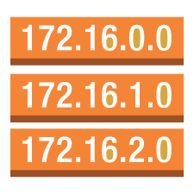


Compute & Networking
Amazon Route 53
Elastic Load Balancing
Amazon Route 53
hosted zone
route table
Elastic Load
Balancing
AWS Direct Connect
AWS Direct Connect
AWS Simple Icons: Compute & Networking

Slide 29


Compute & Networking
Auto Scaling
Elastic Network Instance
Auto Scaling
elastic network instance
AWS Simple Icons: Compute & Networking

Slide 30









Storage & Content Delivery
Amazon Simple Storage Service
AWS Import/Export
Amazon S3
bucket
bucket with objects
object
AWS Import/Export
Amazon Elastic Block Store
AWS Storage Gateway
Amazon EBS
volume
snapshot
AWS Storage Gateway
non-cached volume
cached volume
virtual tape library
AWS Simple Icons: Storage & Content Delivery

Slide 31







Storage & Content Delivery
Amazon Glacier
Amazon Glacier
archive
vault
Amazon CloudFront
CloudFront
download distribution
streaming distribution
edge location
AWS Simple Icons: Storage & Content Delivery

Slide 32










Database
Amazon DynamoDB
DynamoDB
table
item
items
attribute
attributes
global secondary index
Amazon Relational Database Service
Amazon RDS
RDS DB instance
RDS DB instance standby (Multi-AZ)
RDS DB instance read replica
MySQL DB instance
Oracle DB instance
MS SQL instance
AWS Simple Icons: Database

Slide 33





Administration & Security
AWS Directory Service
AWS Config
AWS CloudTrail
AWS Directory Service
AWS Config
AWS CloudTrail
AWS Trusted Advisor
Amazon CloudWatch
AWS Trusted Advisor
CloudWatch
alarm

Slide 34









Administration & Security
AWS Identity and Access Management
IAM
IAM add-on
AWS Security Token Service
data encryption key
encrypted data
permissions
role
long-term security credential
temporary security credential
MFA token

Slide 35







Deployment & Management
AWS Elastic Beanstalk
Elastic Beanstalk
application
deployment
AWS CloudFormation
AWS CodeDeploy
AWS CloudFormation
template
stack
AWS CodeDeploy
AWS Simple Icons: Deployment & Management

Slide 36















Non-Service Specific
AWS cloud
AWS Management Console
virtual private cloud
forums
client
mobile client
multimedia
Internet
user
users
traditional server
corporate data center
disk
generic database
tape storage
AWS Simple Icons: Non-Service Specific

Slide 37













SDKs
Java
JavaScript
Python (boto)
PHP
.NET
Ruby
Node.js
iOS
Android
AWS Toolkit for Visual Studio
AWS Toolkit for Eclipse
AWS Tools for Windows PowerShell
AWS CLI
AWS Simple Icons: SDKs

Slide 38
Groups
Auto Scaling group
Availability Zone
region
security group
Elastic Beanstalk container
EC2 instance contents
VPC subnet
server contents
AWS Simple Icons: Groups

Slide 39
Groups
virtual private cloud
AWS cloud
corporate data center
AWS Simple Icons: Groups

Slide 40
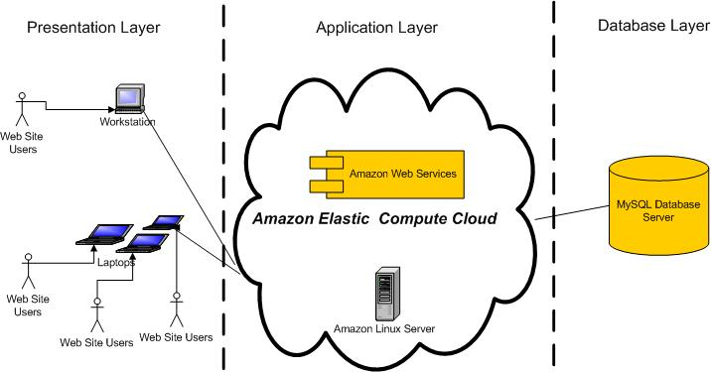
Project’s Architectural Diagram

